Slide 1
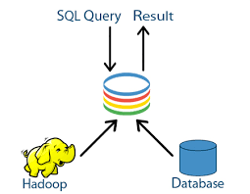
SQL-on-Hadoop: Full Circle Back to Shared-Nothing Database Architectures
Published by:-
Avrilia Floratou IBM Almaden Research Center aflorat@us.ibm.com
Umar Farooq Minhas IBM Almaden Research Center ufminhas@us.ibm.com
Fatma O ̈ zcan IBM Almaden Research Center fozcan@us.ibm.com
Presented by :- Mehul D Ganjude
100190551

Slide 2
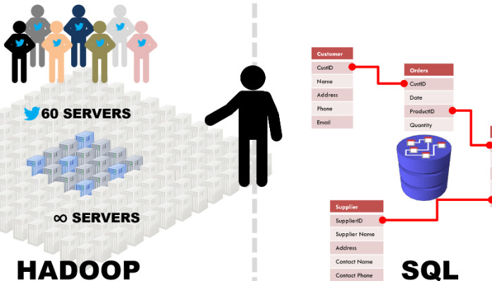
What Does SQL-on-Hadoop Mean?
SQL on Hadoop is a type of analytical application tool — the SQL implementation on the Hadoop platform, which combines standard SQL-style querying of structured data with the Hadoop data framework. Hadoop is a relatively new platform, as is big data itself, and not many professionals are experts in it, but SQL on Hadoop simplifies access to the Hadoop framework and makes it easier to implement on current enterprise systems.
Shared-nothing architecture?
A shared-nothing architecture (SN) is a distributed computing architecture in which each update request is satisfied by a single node in a computer cluster.

Slide 3
INTRODUCTION:
SQL query processing for analytics over Hadoop data has recently gained significant traction. Among many systems providing some SQL support over Hadoop.
Hive is the first native Hadoop system that uses an underlying framework such as MapReduce or Tez to process SQL-like statements. Impala, on the other hand, represents the new emerging class of SQL-on-Hadoop systems.
Hive
Map Reduce
Tez
Impala
Both systems optimize their data ingestion via columnar storage.
It uses a different file formats: ORC , Parquet.

Slide 4
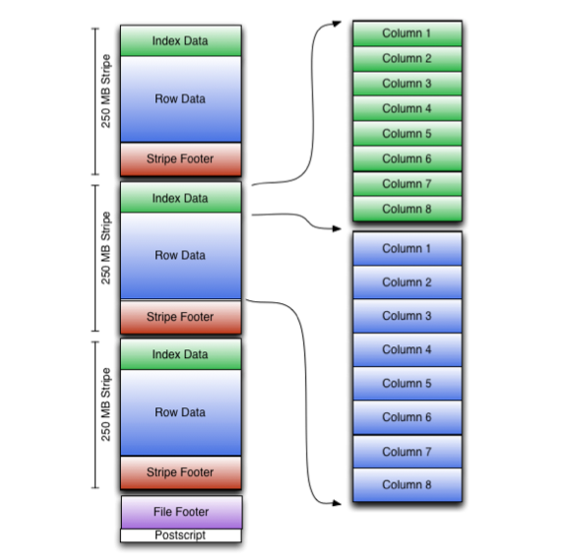
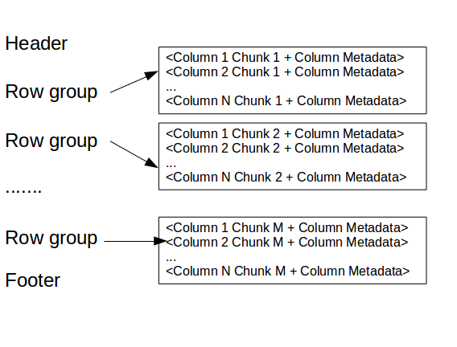
ORC file Format :- (Optimized Row Columnar) is a free and open-source column-oriented data storage format.
Parquet is an open-source file format built to handle flat columnar storage data formats.
Also, it compare the performance of these two systems by conducting a set of cluster experiments using a TPC-H like benchmark and two TPC-DS inspired workloads.

Slide 5
Hadoop as a central data repository for all their data coming from various sources.
They have classified these systems into two general categories: Native Hadoop-based systems, and database-Hadoop hybrids.
NHBS (Native Hadoop-based systems ):-
Hive is the first SQL like system, which uses another framework like Map Reduce or Tez.
Impala runs queries using its own long-running daemons running on every HDFS Data Node, and instead of materializing intermediate results, pipelines them between computation stages.
DHH(Database-Hadoop hybrids):-
It uses the relational database to execute query fragments.
It mainly focus on the first category of native SQL-on- Hadoop systems and investigate the performance of Hive and Impala.
Reason behind picking these two systems due to their popularity as well as their architectural differences.
(There are other SQL-on-Hadoop systems, such as Presto and Tajo but but these systems are mainly used by companies that created them.)
Hive and Impala are used for analytical queries.
We conduct a detailed analysis of Impala and Hive using TPC-H data, stored as text, Parquet and ORC file formats and with the TPC-DS inspired workload.

Slide 6
TPC-H like Workload (Transaction Processing Council Ad-hoc/decision support benchmark)
The TPC-H benchmark provides up to twenty-two decision support queries that must be executed as part of the TPC-H benchmark. Each TPC-H query asks a business question and includes the corresponding query to answer the question.
Hive has now support for nested sub-queries. In order to exploit this feature, we re-wrote 11 TPC-H queries. The remaining queries could not be further optimized since they already consist of a single query. Impala was able to execute these rewritten queries and produce correct results, except for Query 18, which produced incorrect results when nested and had to be split into two queries.
In Hive-MR, we enabled various optimizations including:
a) optimization of correlated queries, b) map-side join and aggregation.
When a query is split into multiple sub-queries, the intermediate results between sub-queries were materialized into temporary tables in HDFS using the same file format.
For Impala, we computed table and column statistics for each table using the COMPUTE STATS statement. These statistics are used to optimize the join order and choose the join methods.

Slide 7
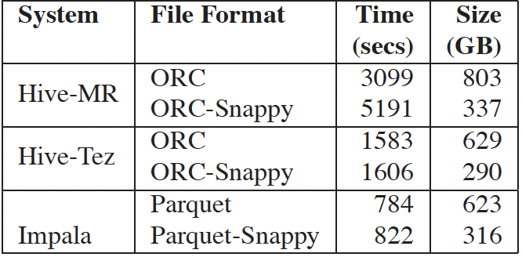
Data Preparation and Load Times
We used the ORC file format in Hive and the Parquet file format in Impala which are the popular columnar formats that each system advertises. We also experimented with the text file format (TXT) in order to examine the performance of each system.
We experimented with all the compression algorithms that are available for each columnar layout, namely snappy and zlib for the ORC file format and snappy and gzip for the Parquet format. Our results show that snappy compression provides slightly better query performance than zlib and gzip, for the TPCH workload, on both file formats. For this reason, we only report results with snappy compression in both Hive and Impala.
Table presents the time to load all the TPC-H tables in each system, for each format that we used. It also shows the aggregate size of the tables.

Slide 8
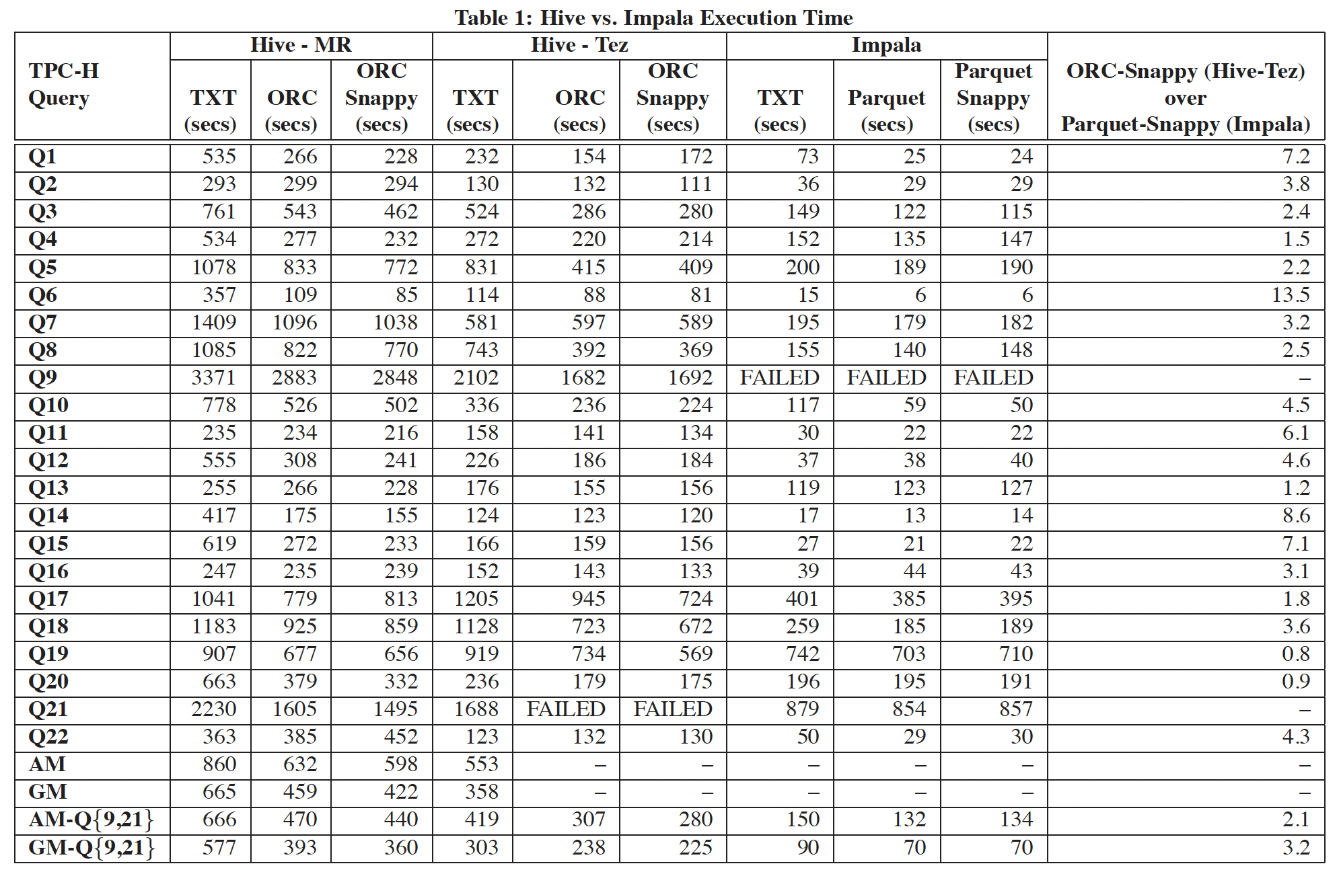
Overall Performance: Hive vs. Impala
In this experiment, we run the 22 TPC-H queries, one after the other, for both Hive and Impala and measure the execution time for each query.
Table presents the running time of the queries in Hive and Impala for each TPC-H query and for each file format that we examined. The last column of the table presents the ratio between Hive-Tez’s response time over Impala’s response time for the snappy compressed ORC file and the snappy compressed Parquet format, respectively. The table also contains the arithmetic (AM) and geometric (GM) mean of the response times for all file formats. The values of AM-Q{9,21} and GM-Q{9,21} correspond to the arithmetic and geometric mean of all the queries but Query 9 and Query 21. Query 9 did not complete in Impala due to lack of sufficient memory and Query 21 did not complete in Hive-Tez when the ORC file format was used since a container was automatically killed.

Slide 9
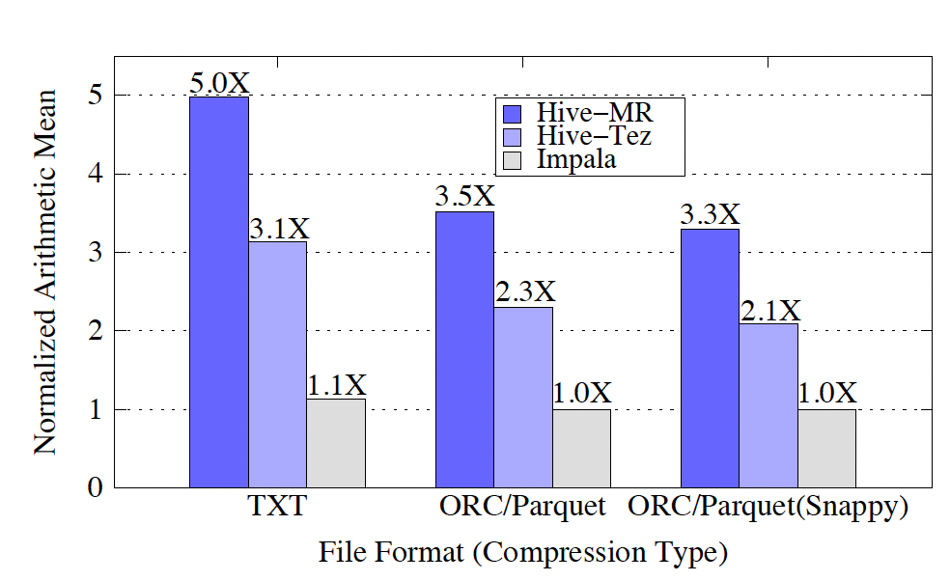
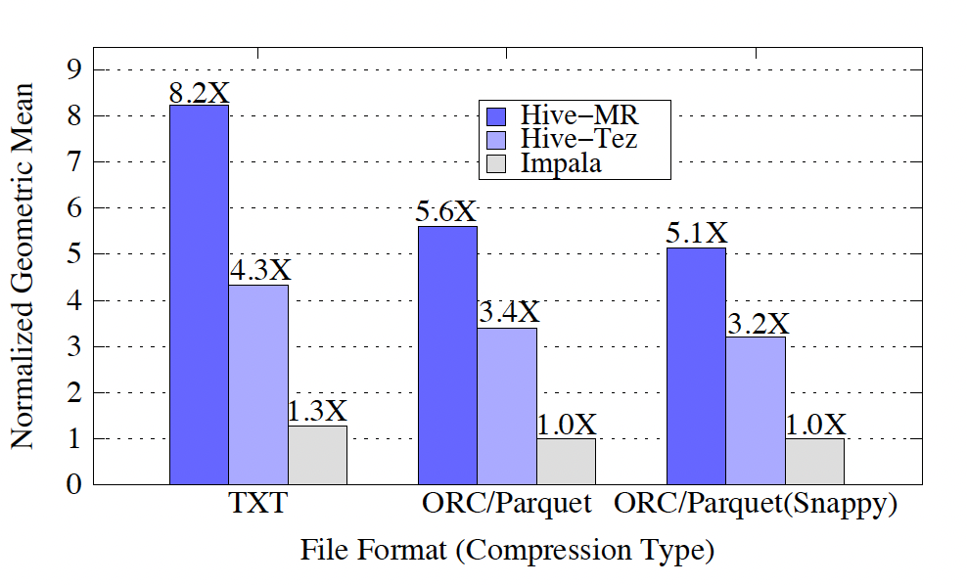
Figure1 shows the normalized arithmetic mean of the response times for the TPC-H queries, and Figure 2 shows the normalized geometric mean of the response times.
Figures 1 and 2 show that Impala outperforms both Hive-MR and Hive-Tez for all the file formats, with or without compression. Impala (using the compressed Parquet format) is about 5X, 3.5X, and 3.3X faster than Hive-MR and 3.1X, 2.3X and 2, 1X faster than Hive-Tez using TXT, uncompressed and snappy compressed ORC file formats, respectively, when the arithmetic mean is the metric used to compare the two systems.

Slide 10

An interesting observation is that Impala’s performance does not significantly improve when moving from the TXT format to the Parquet columnar format. Moreover, snappy compression does not further improve Impala’s performance when the Parquet file format is used. This observation suggests that I/O is not Impala’s bottleneck for the majority of the TPC-H queries.
On the other hand, Hive’s performance improves by approximately 30% when the ORC file is used, instead of the simpler TXT file format. From the results presented in this section, we conclude that Impala can handle TPC-H queries much more efficiently than Hive, when the workload’s working set fits in memory.
This behavior is attributed to the following reasons:
(a) Impala has a far more efficient I/O subsystem than Hive-MR and Hive-Tez, (b) Impala relies on its own long running, daemon processes on each node for query execution. (c) Impala’s query execution is pipelined as opposed to Hive- MR’s MapReduce-based query.

Slide 11
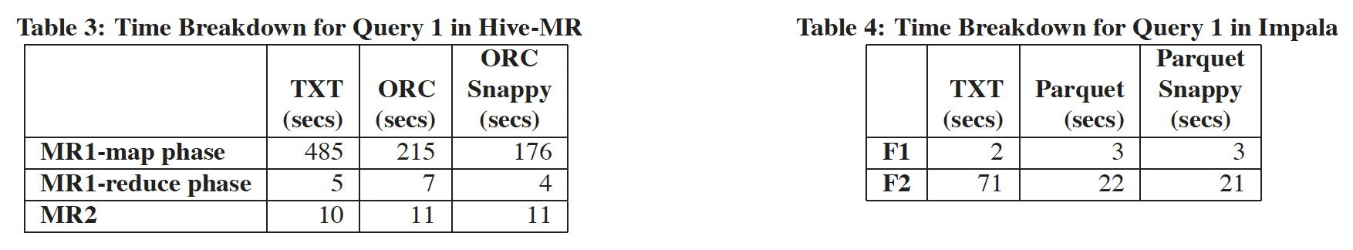
Query behavior changes: Query 1
The TPC-H Query 1 is a query that scans the lineitem table, projects a few columns, performs an aggregation and sorts the final result.
In Hive-MR, the query consists of two MapReduce jobs, MR1 and MR2. During the map phase,MR1 scans the lineitem table, applies the filtering predicate and performs a partial aggregation. In the reduce phase, it performs a global aggregation and stores the results in HDFS.
Impala breaks the query into three fragments, namely F0, F1 and F2. F2 scans the lineitem table and performs a partial aggregation.

Slide 12
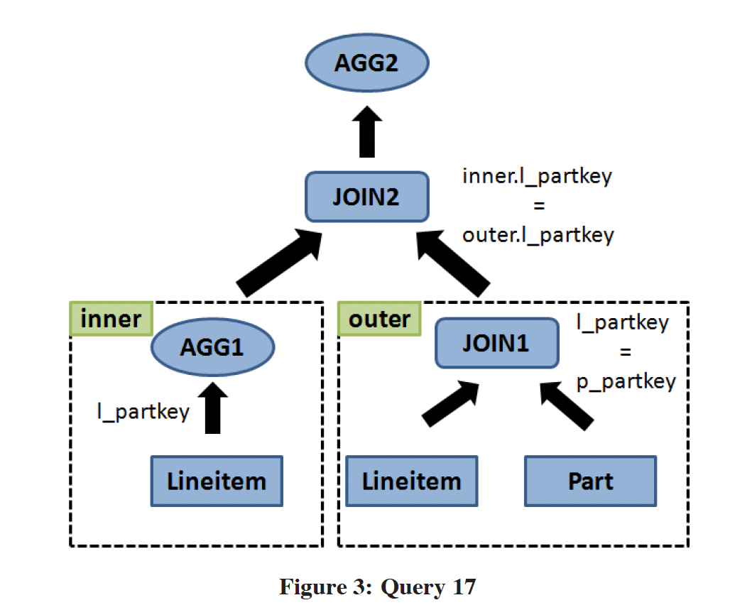
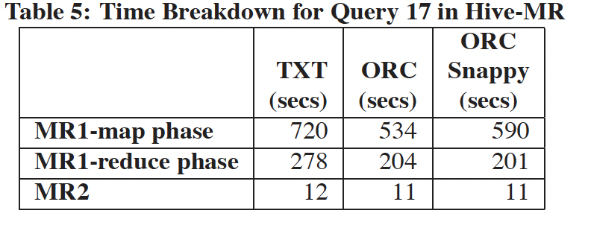
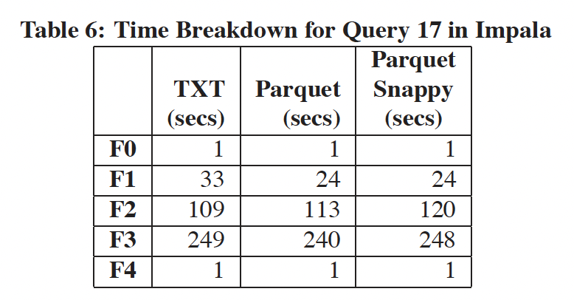
Query behavior changes: Query 17
The TPC-H query 17 is about 2X faster in Impala than Hive-MR. Compared to other workload queries.
Hive-MR generates an optimized query plan that consists of two MapReduce jobs only, namely MR1 and MR2.
In the map phase of MR1, the lineitem and part tables are scanned, In the reduce phase, a global aggregation on the lineitem table is performed.
The second MapReduce job, MR2, reads the output of MR1 and performs a global aggregation.
Impala is not able to identify that the AGG1 and JOIN1 operations share a common input, and thus scans the lineitem table twice.
Impala breaks the query into 5 fragments (F0, F1, F2, F3 and F4).

Slide 13
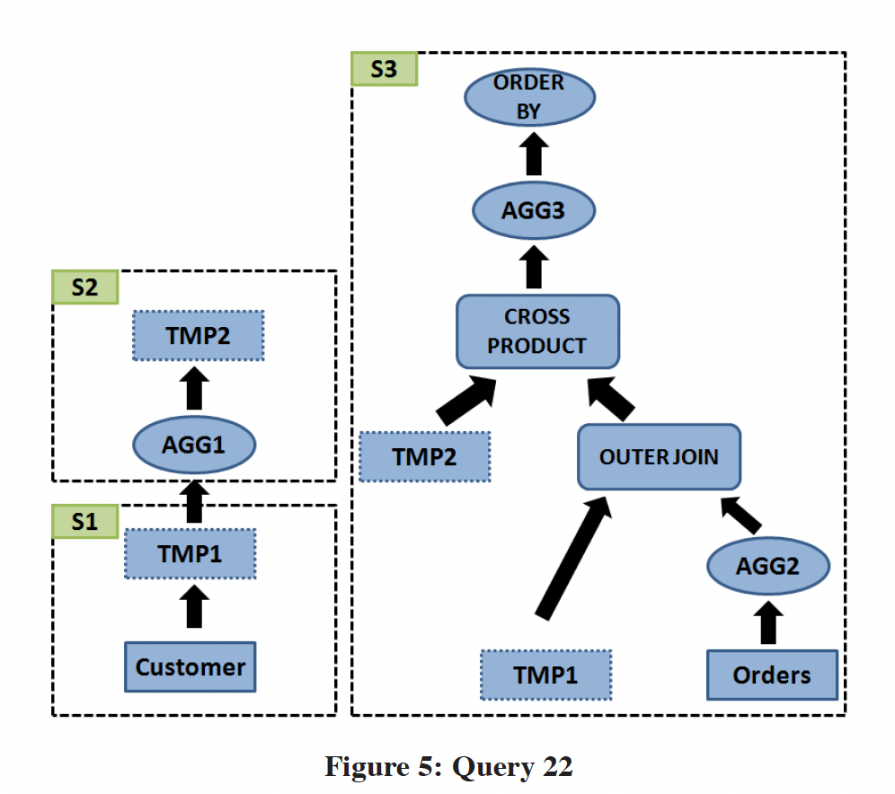
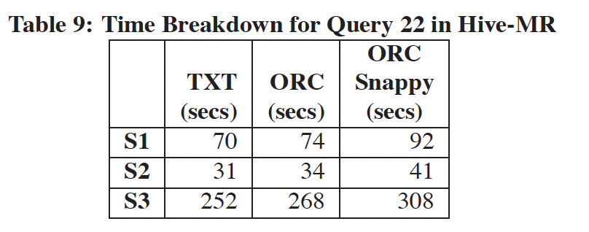
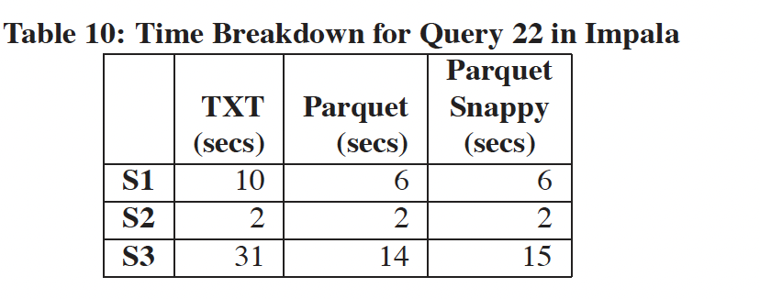
Query behavior changes: Query 22
Query 22 is the query with the most significant performance gain in Impala compared to Hive-MR (15X when using the snappy compressed Parquet format).
Hive-MR uses 7 MapReduce jobs for this query. All had similar behavior
Analysis shows that the time difference between the TXT format and the snappy compressed ORC file is due to increased scan time of the two tables
Impala is faster than Hive-MR in each sub-query, with speedups ranging from 7X to 20.5X
This performance gap is mainly attributed to the fact that Impala has a more efficient I/O subsystem.
Impala breaks sub-query S3 into 7 fragments.

Slide 14
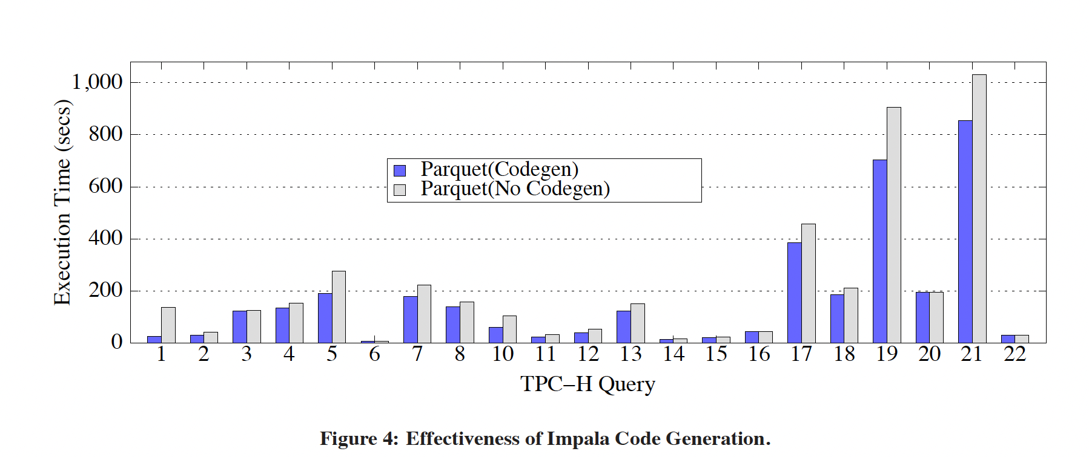
Effectiveness of Runtime Code Generation in Impala
One of the features of Impala is its ability to generate code at runtime to improve CPU efficiency and query execution times.
With runtime code generation enabled, the query execution time improves by about 1.3 for all the queries combined.
TPC-H Query 1 benefits the most from code generation, improving by 5.5X. The remaining queries see benefits up to 1.75X
From the results presented in Figure, we conclude that runtime code generation generally improves overall performance. However, the benefit of code generation varies for different queries.

Slide 15
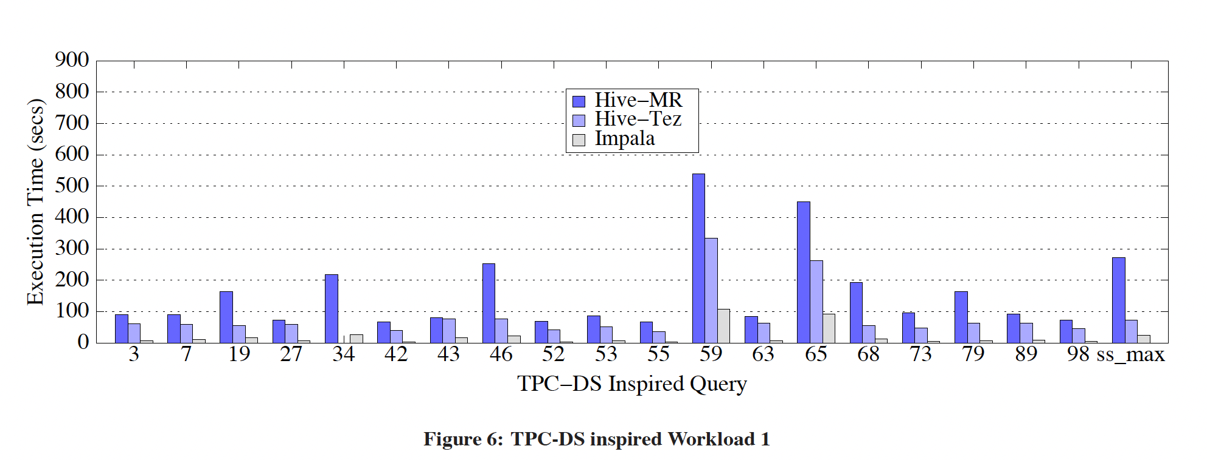
TPC-DS (Decision Support Benchmark) Inspired Workloads
Comparison Hive-MR and Impala on the cluster setup.
In this, experimental setup we use 20 compute nodes connected through a 10Gbit Ethernet switch as opposed to the setup used by the Impala developers which consists of 5 compute nodes connected through a 1Gbit Ethernet switch.
The workload (TPC-DS inspired workload 1) consists of 20 queries which access a single fact table and six-dimension tables. Thus, it significantly differs from the original TPC-DS benchmark that consists of 99 queries that access 7 fact tables and multiple dimension tables.
The predicate values do not match the ones described in the TPC-DS specification for this scale factor..

Slide 16
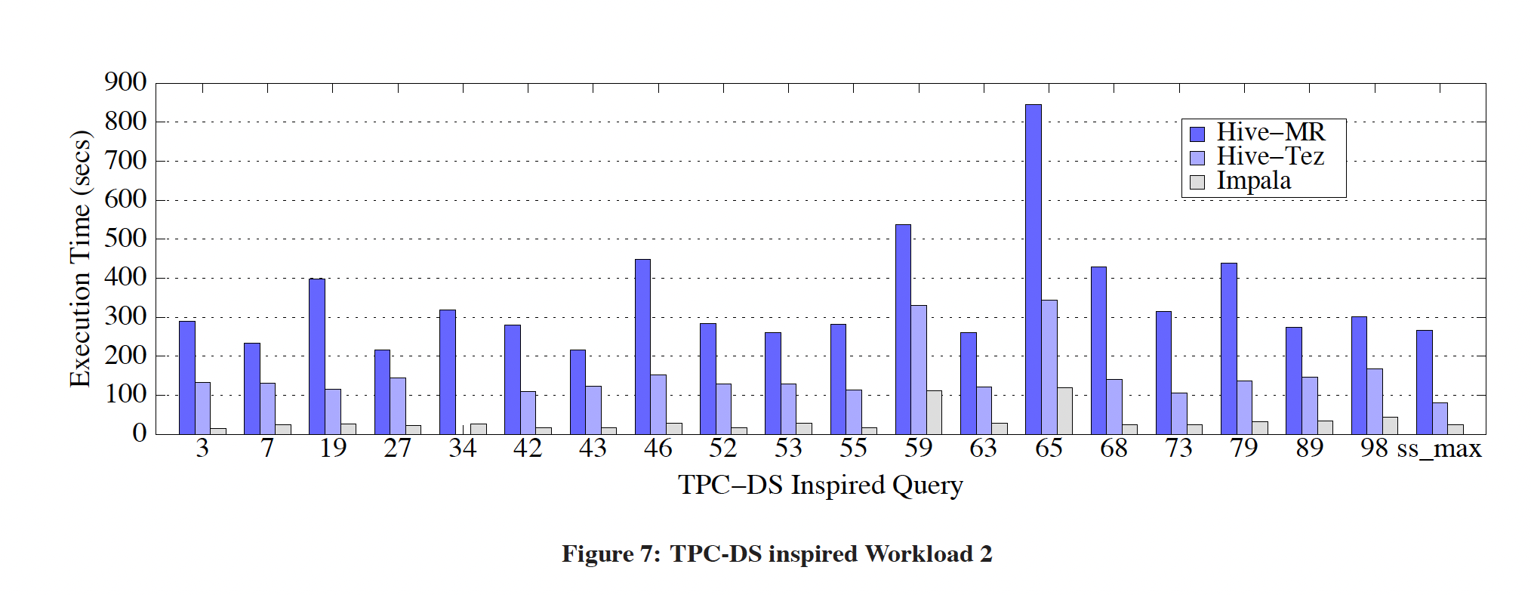
TPC-DS inspired workload 2
Data in Parquet and ORC snappy-compressed file formats.
Results show that Impala is on average 8.2X faster than Hive- MR and 4.3X faster than Hive-Tez on the TPC-DS inspired workload 1 and 10X faster than Hive-MR and 4.4X faster than Hive-Tez on the TPC-DS inspired workload 2.
When Hive-MR merges multiple operations into a single MapReduce job the performance gap between the two systems shrinks.
Hive-MR almost 4X slower than Impala on this query in the TPC-DS inspired workload 1. Hive-MR is 13X slower than Impala for Query 43 of TPC-DS inspired workload 2.

Slide 17
OBSERVATION
As a result, 5 queries of this workload (Q27, Q53, Q63, Q89, Q98) can be executed using the official versions of the TPCDS queries in Hive but not in Impala. We executed these 5 official TPC-DS queries in Hive and observed that the execution time increases at most by 10% compared to the queries in workload 2.
To summarize, we observe similar trends in both TPC-H and TPC-DS inspired workloads. Impala performs better for TPC-DS inspired workloads than the TPC-H like workload because of its specialized optimizations for the query pattern in the workloads.

Slide 18

CONCLUSIONS
experimental evaluation of Impala and Hive, two representatives among SQL-on-Hadoop systems shows different nature when use different file.
We find that Impala provides a significant performance advantage over Hive when the workload’s working set fits in memory.
The performance difference is attributed to Impala’s very efficient I/O sub-system.
Hive on MapReduce pays the overhead of scheduling, Hive on Tez avoids these overheads.
However, both Hive-MR and Hive-Tez are CPU-bound during scan operations which negatively affects their performance.

Slide 19

Thank you

